Slide 1
Linear Regression Part III: Interaction & Non-linear Effects
Dr. Upender Subramanian
MKT/BUAN 6337

Slide 2
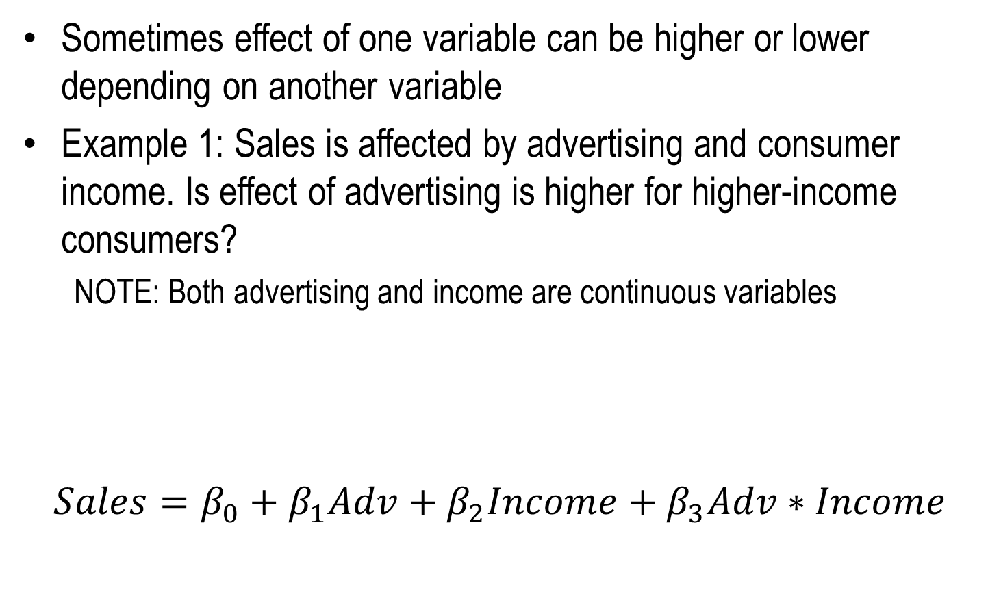
Interaction Effects
Sometimes effect of one variable can be higher or lower depending on another variable
Example 1: Sales is affected by advertising and consumer income. Is effect of advertising is higher for higher-income consumers?
NOTE: Both advertising and income are continuous variables
$$Sales=β_{0}+β_{1}Adv+β_{2}Income+β_{3}Adv∗Income$$
“Main Effects” of Adv, Income
“Interaction Effect” of Adv, Income

Slide 3
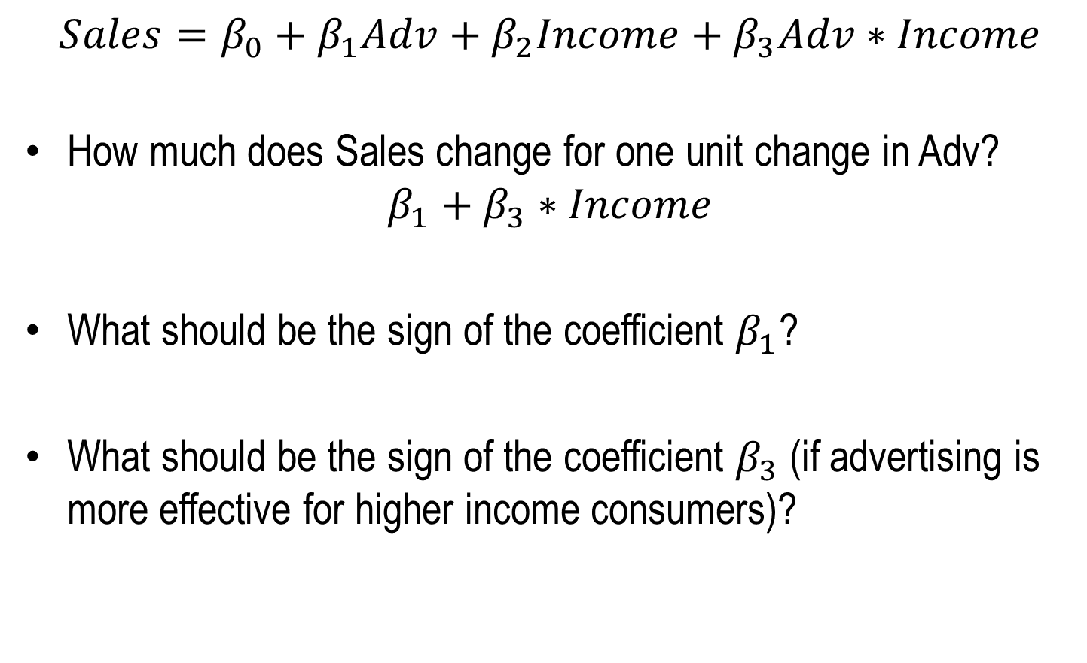
Interaction Effects
$$Sales=β_{0}+β_{1}Adv+β_{2}Income+β_{3}Adv∗Income$$
How much does Sales change for one unit change in Adv?
$$β_{1}+β_{3}∗Income$$
What should be the sign of the coefficient $β_{1}$?
What should be the sign of the coefficient $β_{3}$ (if advertising is more effective for higher income consumers)?

Slide 4
Interaction Effects
NOTE: NEVER include interaction effect without main effects
Even if (coefficient of) main effect is not significant
NOTE: Do not interpret the main effect without looking at the interaction
E.g., Sales = 100 - 10*Adv + 10*Income + 100*Adv*Income
Is effect of advertising on sales positive or negative ?
Standardize variables to avoid misinterpretation

Slide 5
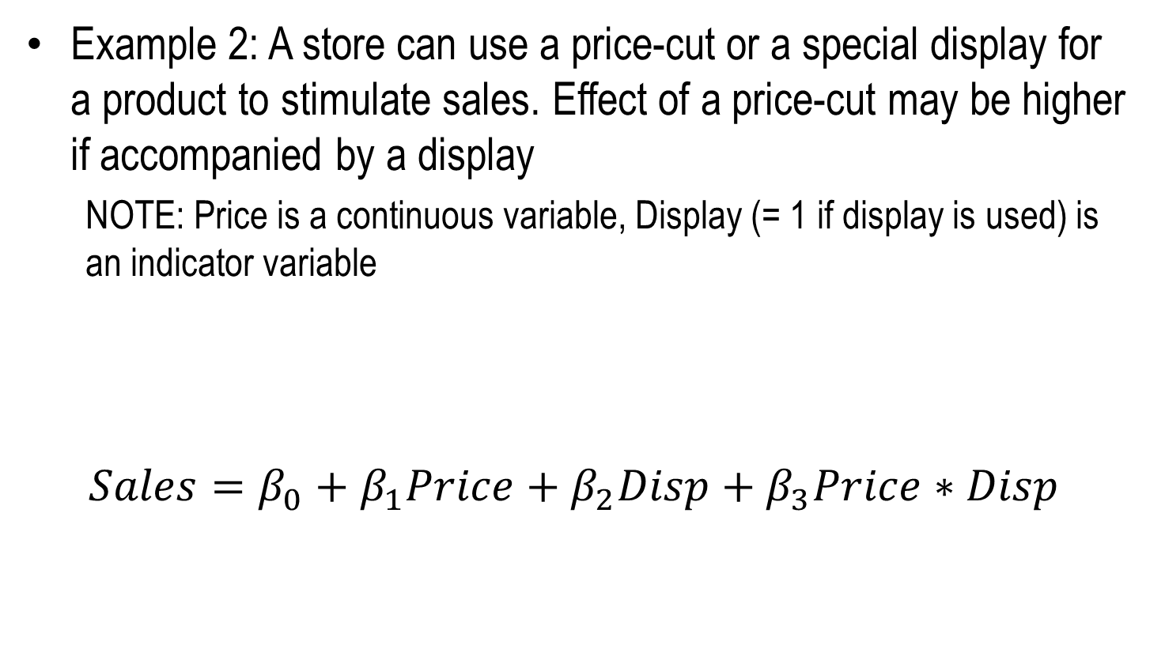
Interaction Effects
Example 2: A store can use a price-cut or a special display for a product to stimulate sales. Effect of a price-cut may be higher if accompanied by a display
NOTE: Price is a continuous variable, Display (= 1 if display is used) is an indicator variable
$$Sales=β_{0}+β_{1}Price+β_{2}Disp+β_{3}Price∗Disp$$
“Main Effects” of Price, Disp
“Interaction Effect” of Price, Disp

Slide 6
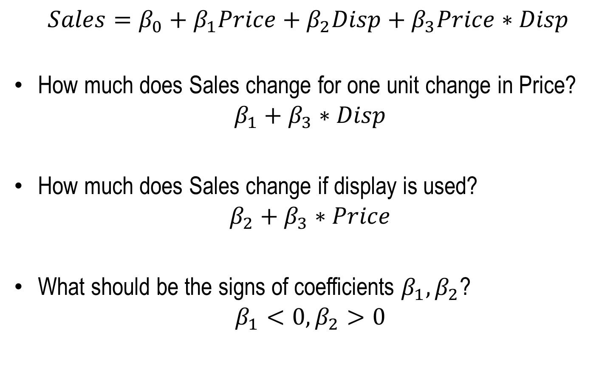
Interaction Effects
$$Sales=β_{0}+β_{1}Price+β_{2}Disp+β_{3}Price∗Disp$$
How much does Sales change for one unit change in Price?
$$β_{1}+β_{3}∗Disp$$
How much does Sales change if display is used?
$$β_{2}+β_{3}∗Price$$
What should be the signs of coefficients $β_{1},β_{2}$?
$$β_{1}<0,β_{2}>0$$

Slide 7
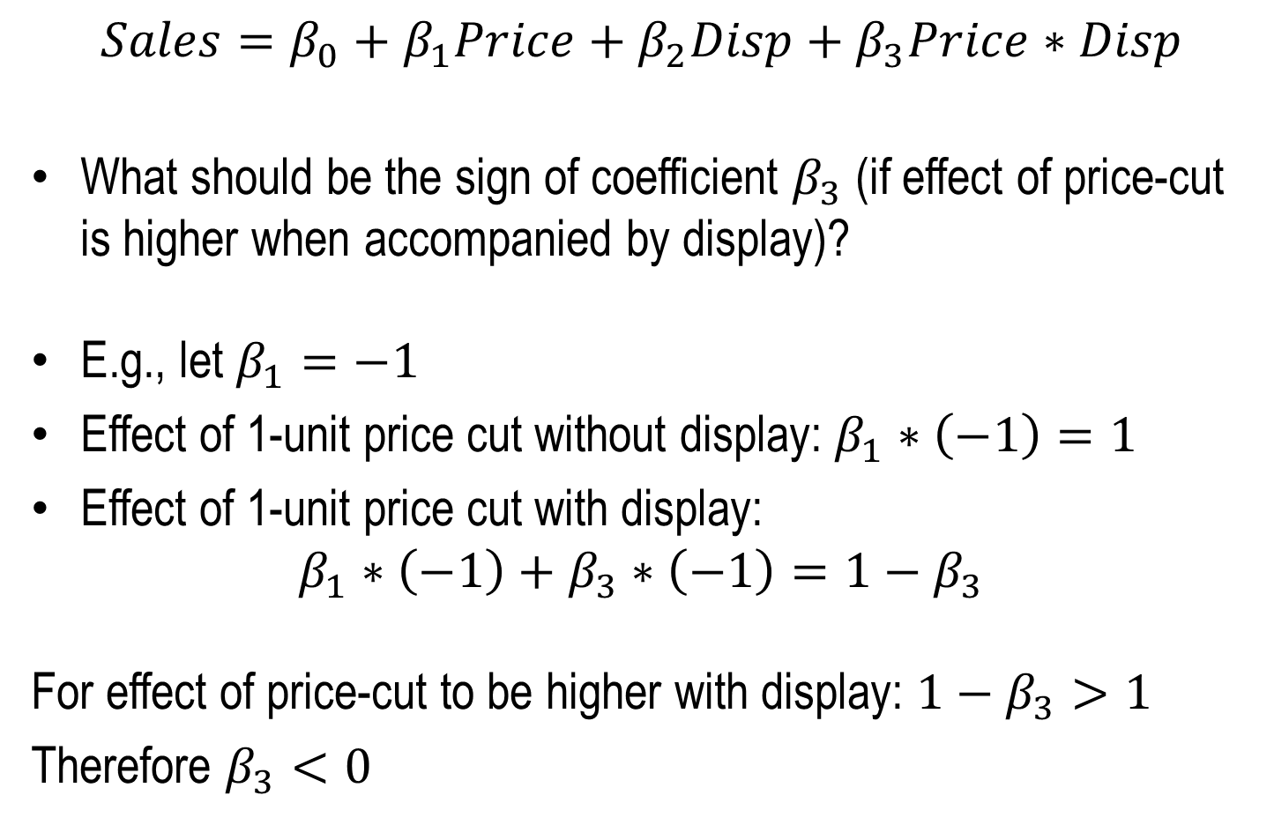
Interaction Effects
$$Sales=β_{0}+β_{1}Price+β_{2}Disp+β_{3}Price∗Disp$$
What should be the sign of coefficient $β_{3}$ (if effect of price-cut is higher when accompanied by display)?
E.g., let $β_{1}=−1$
Effect of 1-unit price cut without display: $β_{1}∗\left(−1\right)=1$
Effect of 1-unit price cut with display:
$$β_{1}∗\left(−1\right)+β_{3}∗\left(−1\right)=1−β_{3}$$
For effect of price-cut to be higher with display: $1−β_{3}>1$
Therefore $β_{3}<0$

Slide 8
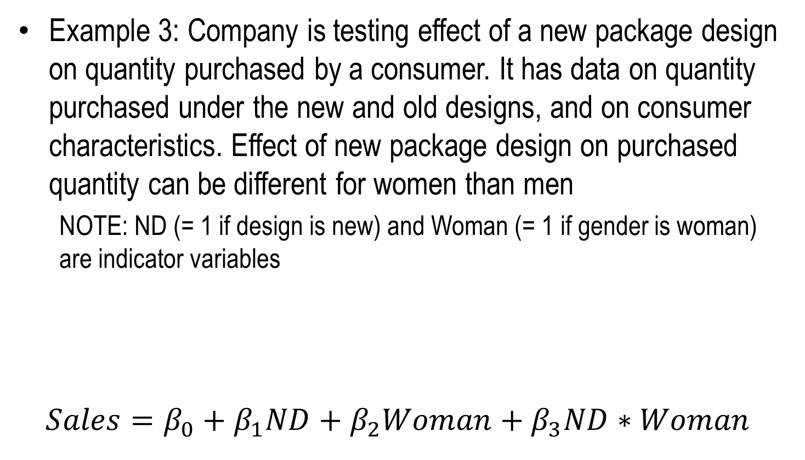
Interaction Effects
Example 3: Company is testing effect of a new package design on quantity purchased by a consumer. It has data on quantity purchased under the new and old designs, and on consumer characteristics. Effect of new package design on purchased quantity can be different for women than men
NOTE: ND (= 1 if design is new) and Woman (= 1 if gender is woman) are indicator variables
$$Sales=β_{0}+β_{1}ND+β_{2}Woman+β_{3}ND∗Woman$$
“Main Effects” of Price, Disp
“Interaction Effect” of Price, Disp

Slide 9
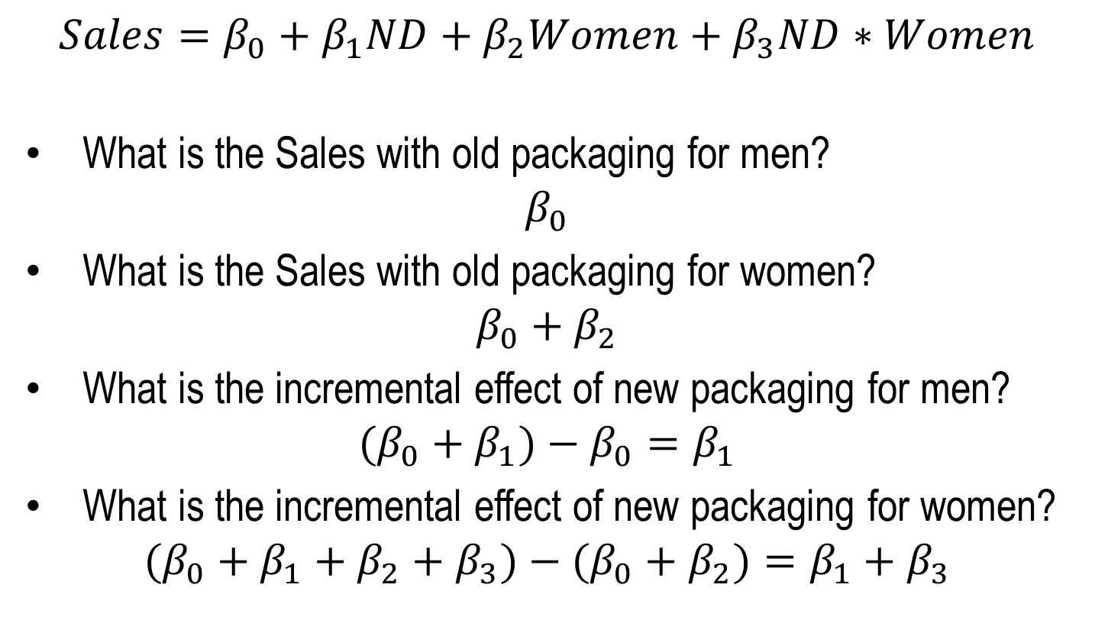
Interaction Effects
$$Sales=β_{0}+β_{1}ND+β_{2}Women+β_{3}ND∗Women$$
What is the Sales with old packaging for men?
$$β_{0}$$
What is the Sales with old packaging for women?
$$β_{0}+β_{2}$$
What is the incremental effect of new packaging for men?
$$(β_{0}+β_{1})−β_{0}=β_{1}$$
What is the incremental effect of new packaging for women?
$$(β_{0}+β_{1}+β_{2}+β_{3})−(β_{0}+β_{2})=β_{1}+β_{3}$$

Slide 10
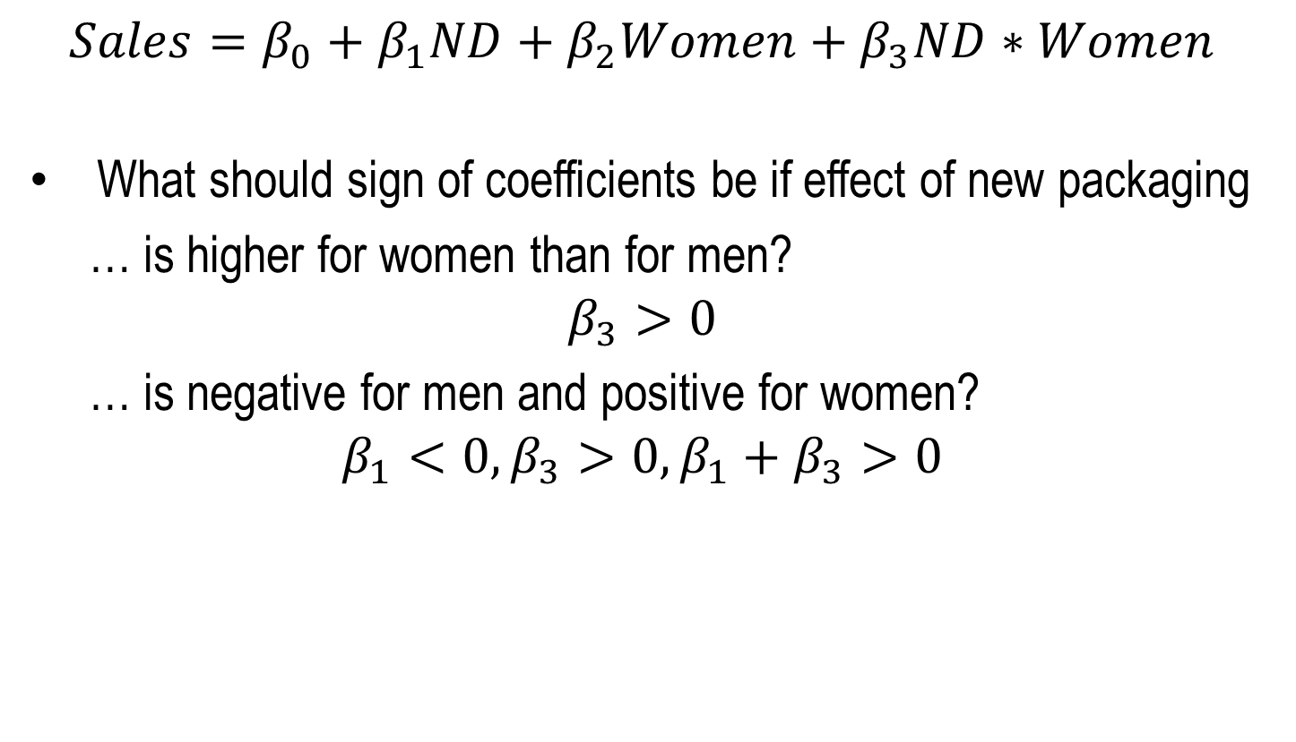
Interaction Effects
$$Sales=β_{0}+β_{1}ND+β_{2}Women+β_{3}ND∗Women$$
What should sign of coefficients be if effect of new packaging
… is higher for women than for men?
$$β_{3}>0$$
… is negative for men and positive for women?
$$β_{1}<0,β_{3}>0,β_{1}+β_{3}>0$$

Slide 11
Segment Response Models
Recall: Segments differ in their needs AND (therefore) how they respond to marketing actions
Suppose data has segmentation variables
Could be demographics or behavioral variables, or segment identifier variables based on previous segmentation analysis
Approach 1: Breakdown dataset by segmentation variables, Build separate response models for each segment
Less data to estimate each model
Approach 2: Build a common model with interaction effects between segment variables and some/all other variables
Can include interactions only for those other variables of interest

Slide 12
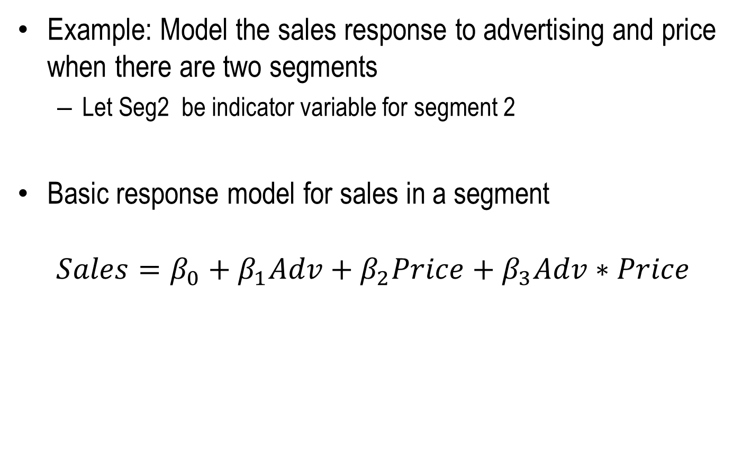
Segment Response Models
Example: Model the sales response to advertising and price when there are two segments
Let Seg2 be indicator variable for segment 2
Basic response model for sales in a segment
$$Sales=β_{0}+β_{1}Adv+β_{2}Price+β_{3}Adv∗Price$$

Slide 13
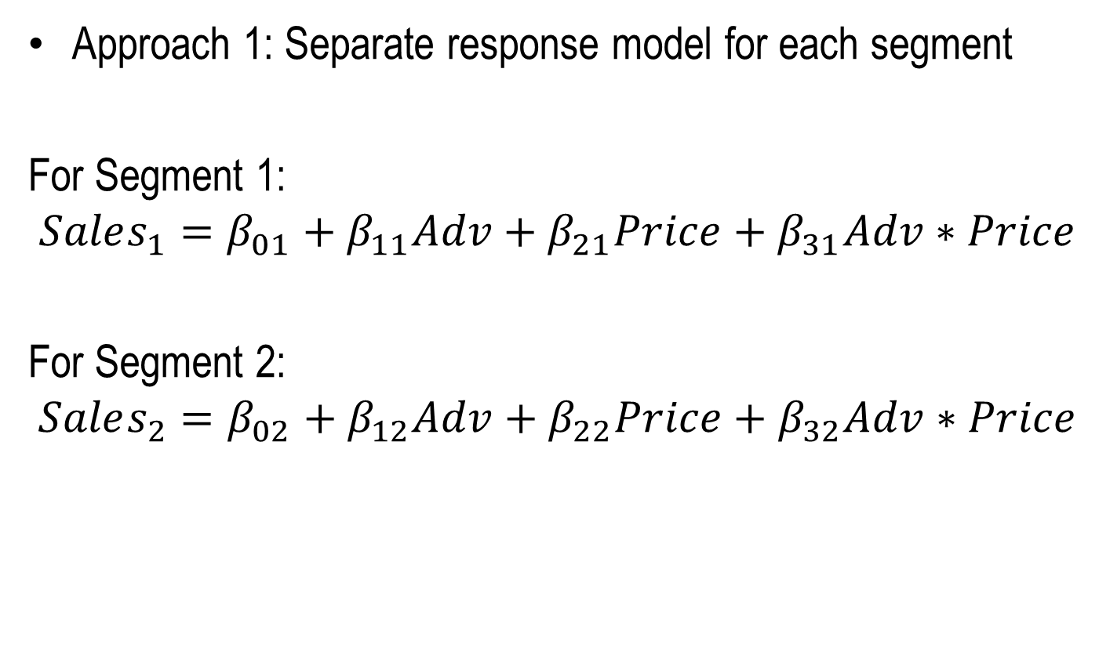
Segment Response Models
Approach 1: Separate response model for each segment
For Segment 1:
$$Sales_{1}=β_{01}+β_{11}Adv+β_{21}Price+β_{31}Adv∗Price$$
For Segment 2:
$$Sales_{2}=β_{02}+β_{12}Adv+β_{22}Price+β_{32}Adv∗Price$$

Slide 14
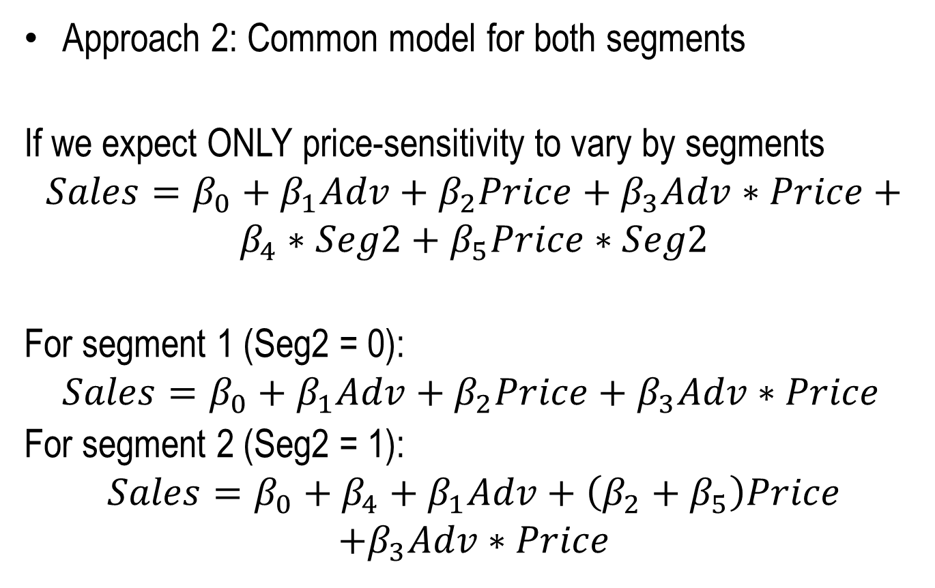
Segment Response Models
Approach 2: Common model for both segments
If we expect ONLY price-sensitivity to vary by segments
$$Sales=β_{0}+β_{1}Adv+β_{2}Price+β_{3}Adv∗Price+$$
$$β_{4}∗Seg2+β_{5}Price∗Seg2$$
For segment 1 (Seg2 = 0):
$$Sales=β_{0}+β_{1}Adv+β_{2}Price+β_{3}Adv∗Price$$
For segment 2 (Seg2 = 1):
$$Sales=β_{0}+β_{4}+β_{1}Adv+\left(β_{2}+β_{5}\right)Price$$
$$+β_{3}Adv∗Price$$

Slide 15
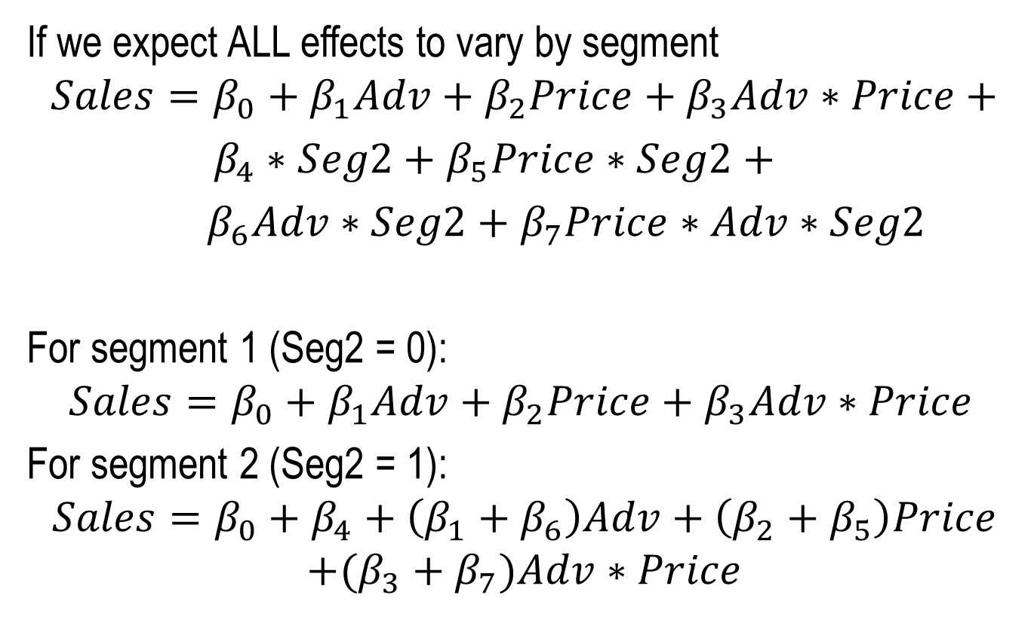
Segment Response Models
If we expect ALL effects to vary by segment
$$Sales=β_{0}+β_{1}Adv+β_{2}Price+β_{3}Adv∗Price+$$
$β_{4}∗Seg2+β_{5}Price∗Seg2+$
$β_{6}Adv∗Seg2+β_{7}Price∗Adv∗Seg2$
For segment 1 (Seg2 = 0):
$$Sales=β_{0}+β_{1}Adv+β_{2}Price+β_{3}Adv∗Price$$
For segment 2 (Seg2 = 1):
$$Sales=β_{0}+β_{4}+\left(β_{1}+β_{6}\right)Adv+\left(β_{2}+β_{5}\right)Price$$
$$+(β_{3}+β_{7})Adv∗Price$$

Slide 16
Approach 1 vs. Approach 2
Approach 2 uses more data to estimate parameters, but assumes variance of error term is same across segments
More data => smaller standard errors for parameters, higher t values
If error variance differs considerably between segments, standard errors and t-values are incorrect
Estimate combined model, check if distribution of residuals are similar between different segments
E.g., Kolmogrov-Smirnov test to compare distributions
If all effects vary with segments, then the two approaches should only differ in standard error estimates
Both approaches will yield equivalent parameter estimates
If standard errors are very different then use Approach 1

Slide 17
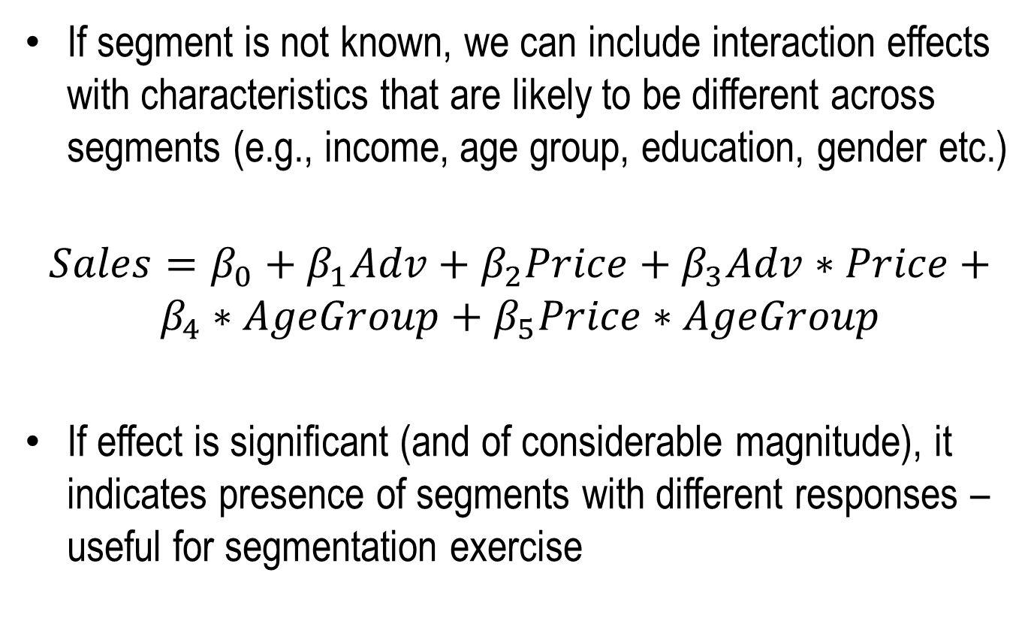
Segment Response Models
If segment is not known, we can include interaction effects with characteristics that are likely to be different across segments (e.g., income, age group, education, gender etc.)
$$Sales=β_{0}+β_{1}Adv+β_{2}Price+β_{3}Adv∗Price+$$
$$β_{4}∗AgeGroup+β_{5}Price∗AgeGroup$$
If effect is significant (and of considerable magnitude), it indicates presence of segments with different responses – useful for segmentation exercise

Slide 18
Synergistic vs. Counterproductive Effects
Managers think in terms of whether two actions or variables produce a synergistic or counterproductive effect
Is effect of jointly changing two variables, higher or lower than the combined effect of changing each variable alone?
Synergistic Interaction Effect: When two variables / actions reinforce each other’s effects
E.g., price and advertising, feature ad and display
A negative interaction effect can still be synergistic – depends on sign of coefficient for main effect (e.g., price and advertising)

Slide 19
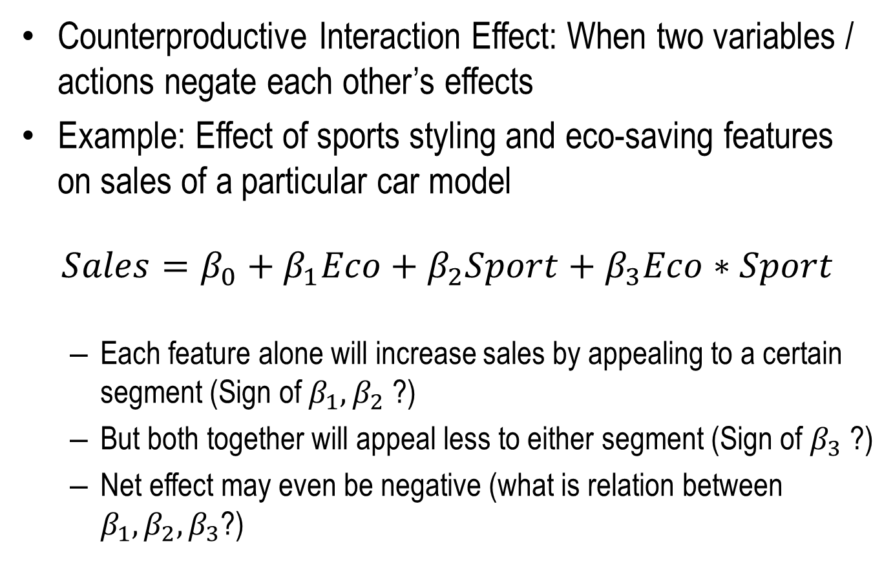
Synergistic vs. Counterproductive Effects
Counterproductive Interaction Effect: When two variables / actions negate each other’s effects
Example: Effect of sports styling and eco-saving features on sales of a particular car model
$$Sales=β_{0}+β_{1}Eco+β_{2}Sport+β_{3}Eco∗Sport$$
Each feature alone will increase sales by appealing to a certain segment (Sign of $β_{1},β_{2}$ ?)
But both together will appeal less to either segment (Sign of $β_{3}$ ?)
Net effect may even be negative (what is relation between $β_{1},β_{2},β_{3}$?)

Slide 20
Non-Linear Effects
Effect of a variable changes with the level of that variable
Example: Effect of advertising on sales is lower for higher levels of advertising
Approach 1: Express effect as a non-linear function of variable
Apply non-linear transformation (e.g., log, sqrt) to the variable
Use transformed values in regression
Approach 2: Include higher-order (polynomial) terms of the same variable
Multiple terms from that variable in the regression
Can be difficult to interpret individual coefficients

Slide 21
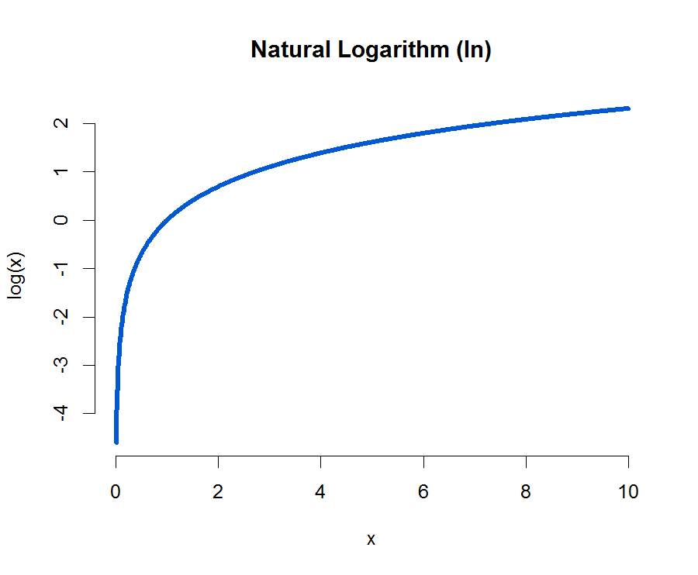
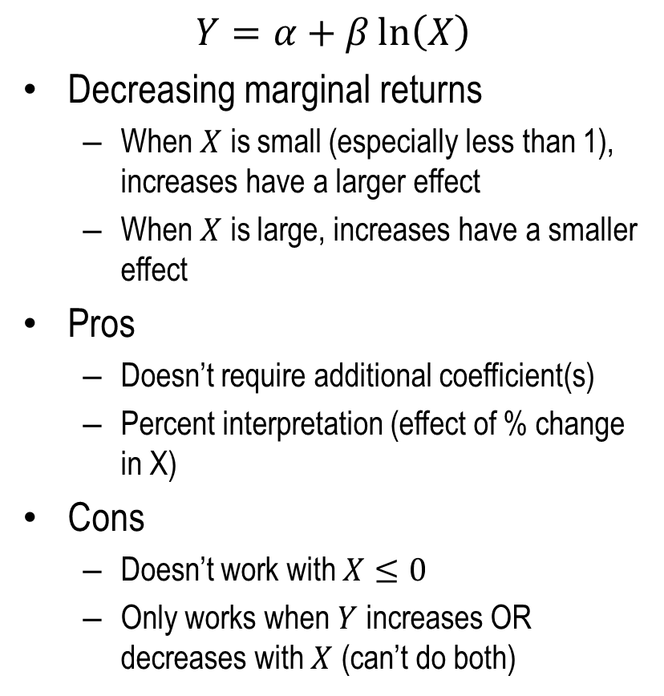
Natural Logarithm Transformations
$$Y=α+β\ln\left(X\right)$$
Decreasing marginal returns
When $X$ is small (especially less than 1), increases have a larger effect
When $X$ is large, increases have a smaller effect
Pros
Doesn’t require additional coefficient(s)
Percent interpretation (effect of % change in X)
Cons
Doesn’t work with $X≤0$
Only works when $Y$ increases OR decreases with $X$ (can’t do both)

Slide 22
Sales is Nonlinearly Related to Advertising Fitting a linear line is not sensible

Slide 23

Sales is Linearly Related to LN(Advertising) We will estimate the following:
$$Y=41.089+8.035×\ln\left(X\right)$$

Slide 24
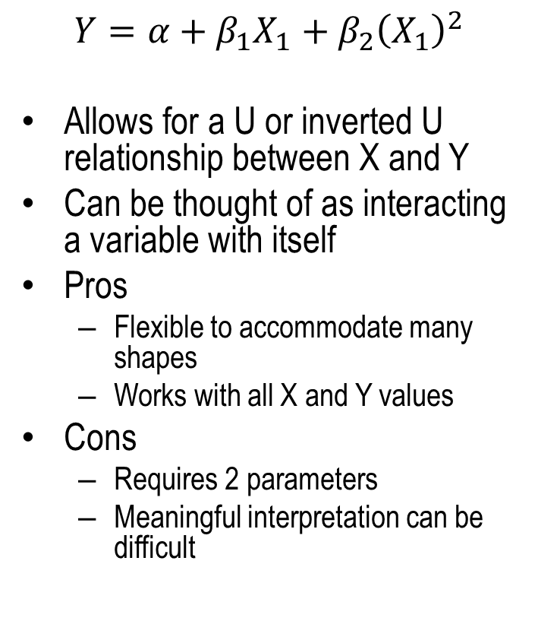
Adding Polynomial Terms
$$Y=α+β_{1}X_{1}+β_{2}{\left(X_{1}\right)}^{2}$$
Allows for a U or inverted U relationship between X and Y
Can be thought of as interacting a variable with itself
Pros
Flexible to accommodate many shapes
Works with all X and Y values
Cons
Requires 2 parameters
Meaningful interpretation can be difficult

Slide 25
Adding Polynomial Terms
We know that advertising affects sales in a non-linear manner.
Sales = a + b₁*ad + b₂*ad²
If b₁ is positive and b₂ is negative
you will get a curvilinear shape for sales.
Sales will first increase and the decrease
as the squared term becomes larger.
If b₁ is negative and b₂ is positive then
you will get a different curve as shown.
Sales
Advertising $
Notes:
Quadratic – what is the effect of a + or a - ?
Can we use other non-linear functions of A? Is it still a linear regression?
Non-linear models
Example – saturation of advertising
Sign of co-efficients and shape of curve (quadratic curve)
Check for interactions and non-linearities (if plausible)
Multiplicative model: Y = a * X^b1 * Y^b2; example market share = price + advertising
Log-log model, coefficient directly gives elasticity.
Log-linear model,

Slide 26
Adding Polynomial Terms
$$Sales=24.39+17.88×Ad−2.96×{Ad}^{2}$$

Slide 27
Non-Linear Effects
Approach 3: Apply non-linear transformation to outcome variable (and possibly also to explanatory variable)
Log-log models
Used to model (linear) relation between % change in outcome with % change in explanatory variable
Example: Model sales of products in different categories
Products differ in their price levels and sales levels
1$ change for product priced at $30 is likely to have less effect than for product priced at $5
Model with linear effects of variables will force effects to be same in both cases
Better to model relation between % change in sales of product with % change in price of that product

Slide 28
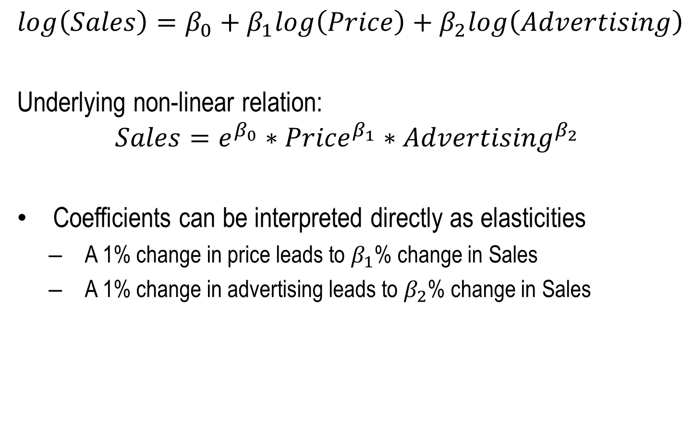
Log-Log models
$$log\left(Sales\right)=β_{0}+β_{1}log\left(Price\right)+β_{2}log\left(Advertising\right)$$
Underlying non-linear relation:
$$Sales=e^{β_{0}}∗{Price}^{β_{1}}∗{Advertising}^{β_{2}}$$
Coefficients can be interpreted directly as elasticities
A 1% change in price leads to $β_{1}$% change in Sales
A 1% change in advertising leads to $β_{2}$% change in Sales

